Slide 1
Photos and Cuckoos

Slide 2

Alice’s Photos
Alice has a lot of photos in her computer
In order to ensure her photos are safe, she also keep a copy of all photos on an online server

Slide 3

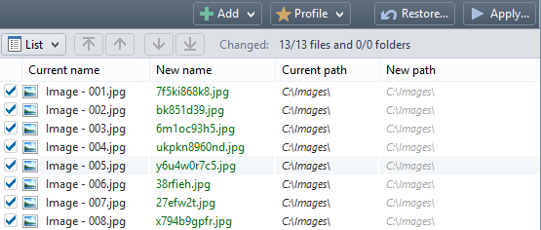
Unfortunately…
Her computer is infected with virus
And some of her photos are deleted
And, the virus also messed up all the file names, changed all of them into some random names

Slide 4
Hash-based Signature
Since Alice has too many photos, it’s very time consuming to download ALL from the online server again
She would like to download the missing photos only
She had n photos and they are on the servers, but her computer has only m remaining photos now

Slide 5
Proposal One
Choose a hash function h to map each photo to an integer k ranging from 1 to n
Hash all photos on Alice’s computer, put all these hash values to a file F

Slide 6



On the Server
For each photo p on the server
Calculate h(p), transmit the hash value to Alice’s computer
if h(p) is not in F, then download the file p from the server to Alice’s computer
Alice claims that it will restore all the lost photos
Explain:
Notes:
The problem of proposal 1 is that you may miss out downloading a missing file because of hash collision (Alice thinks she already has it locally due to an accidental matching hash output (h(p) matches something in file F), but actually that hash output h(p) matches ANOTHER file that just happens to be present on her computer

Slide 7
Proposal Two
Choose a new random function h
For every photos on Alice’s computer, save all the hash values to a file F
Do the same on the server, save every hash value in a file G and send it (file G) to Alice’s computer
If ( |G| - |F| ) != ( n – m )
Repeat from the beginning with another hash function
Otherwise, download those photos (files with hashes in G but not in F) and terminate
Notes:
When |G| - |F| ) == ( n – m ), we know that among the n-m (the number of missing files), there is no collision, hence |G|-|F| == n-m, and we can use the hashes in G that is not in F to identify the missing files

Slide 8
In Fact
Think of how all online storage/clouds sync with your files on your computer when you can perform any modification or deletion on your own computer

Slide 9
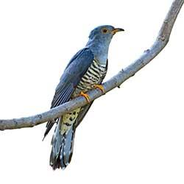
Cuckoo
From Merriam-Webster Dictionary:
a largely grayish-brown European bird (Cuculus canorus) that is a parasite given to laying its eggs in the nests of other birds which hatch them and rear the offspring
a silly or slightly crackbrained person
布谷鸟, कोयल, কোকিল, gila, 鳩

Slide 10
Cuckoo Hashing
We use two hash tables, A and B, of size m = 2n to store n items
For hash table A, we use hash function f
For hash table B, we use hash function g
To insert an item x, we start by
insert(x, A, f)

Slide 11
Abstract of insert()
insert(item x, Table T, function h)
slot = h(x)
z = T[slot] // cuckoo expel!
T[slot] = x
if (z != null)
if (T == A)
insert(z, B, g)
else if (T == B)
insert(z, A, f)

Slide 12

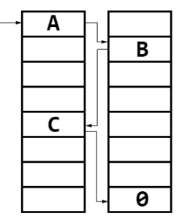
Evicting
When we insert something, we collide with A. A will evict B, B evict C, C finds an empty slot so the search terminates.

Slide 13
Search?
search(x)
if (A[f(x)] == x)
return A[f(x)];
if (B[g(x)] == x)
return B[g(x)];
else
return NOT_IN_TABLE;
Extremely fast!

Slide 14


Problem?
insert(item x, Table T, function h)
slot = h(x)
z = T[slot]
T[slot] = x
if (z != null)
if (T == A)
insert(z, B, g)
else if (T == B)
insert(z, A, f)

Slide 15
Problem?
If we have been evicting more than 2m steps, we got a problem
A cycle exists
Suggestion what to do if it happens?

Slide 16

Solution?
Choose two new hash functions and hash every item again!!!

Slide 17

Solution?
Choose two new hash functions and hash every item again!!!
In fact, that’s the correct way to do!!
Every insertion has an expected chance of O(1/n²) to fail
So O(1/n) fail for n items
Expected amortized cost is
O(1)

Slide 18
If you don’t believe
www.it-c.dk/people/pagh/papers/cuckoo-undergrad.pdf
http://infoweekly.blogspot.sg/2010/02/cuckoo-hashing.html
http://mybiasedcoin.blogspot.sg/2007/06/cuckoo-hashing-theory-and-practice-part.html

